Slide 1
AI - Discovery
Concepts
Notes:
Slides courtesy of Bram Heyns

Slide 2

Definition of A.I.
Discovery
Many, many, many different definitions of AI
Pretty good one:
‘Theory and development of technology able to perform tasks normally requiring human intelligence’

Slide 3
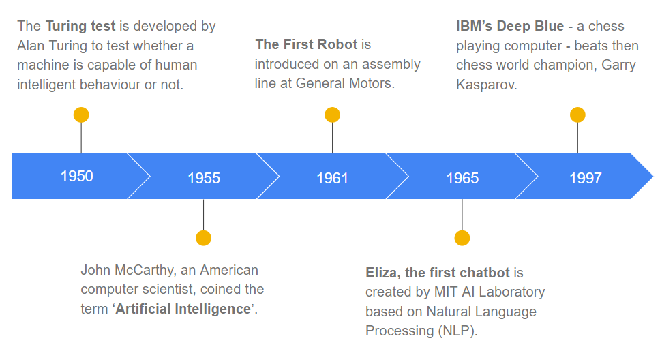
History of AI
Discovery

Slide 4
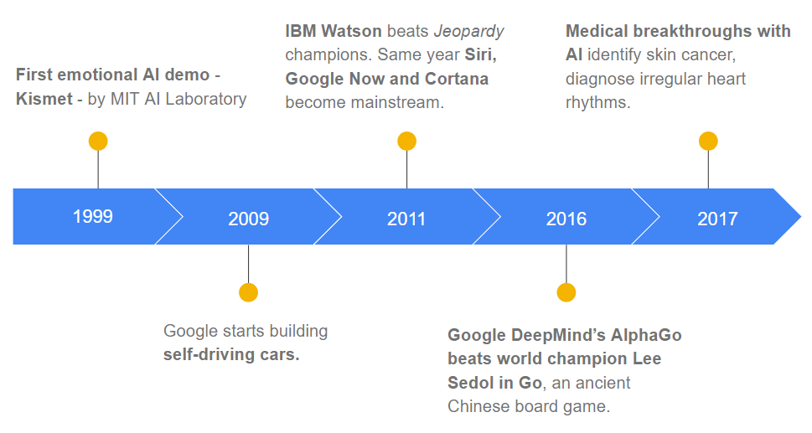
History of AI
Discovery

Slide 5
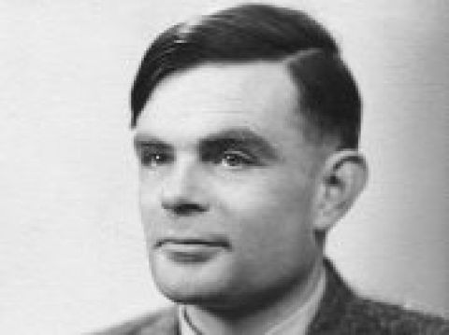
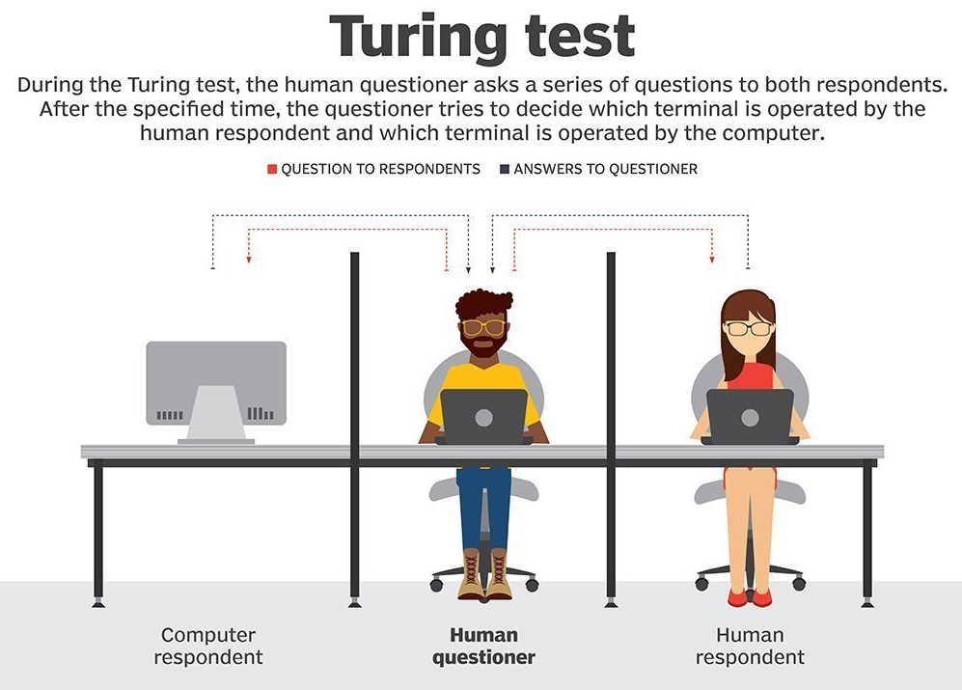
Turing Test
Discovery

Slide 6
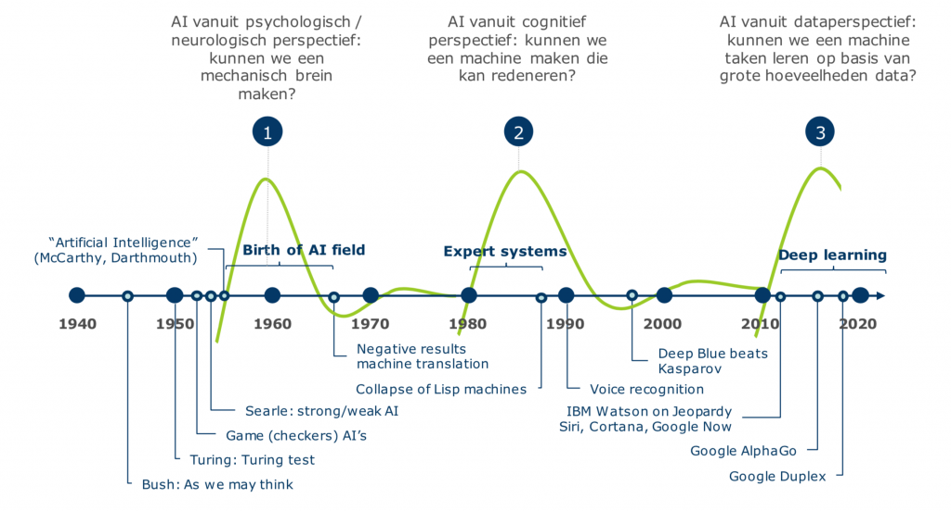
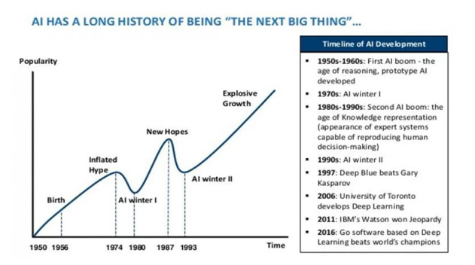
History of A.I.
Discovery

Slide 7
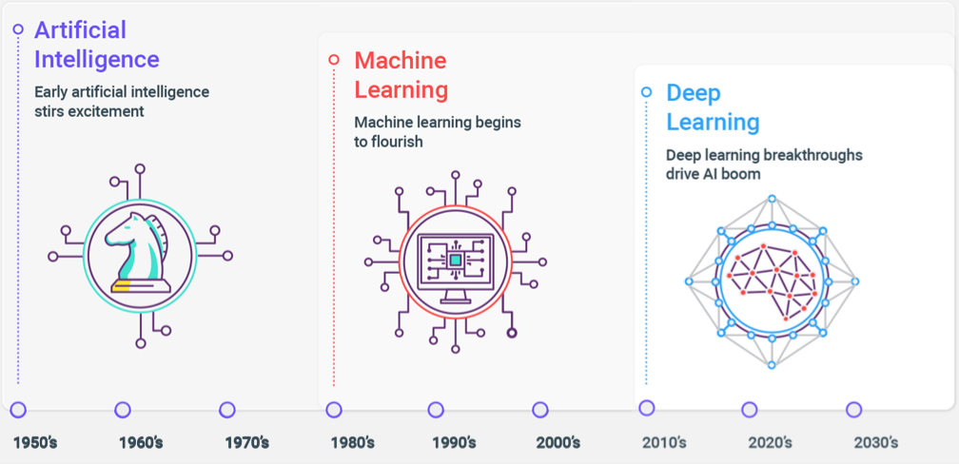

History of A.I.
Discovery

Slide 8
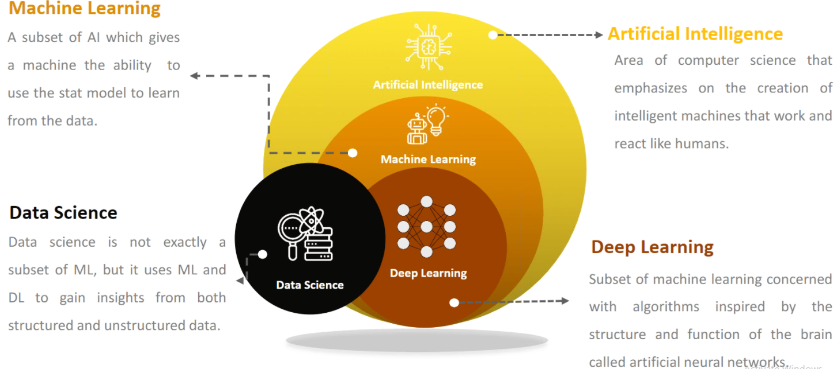
AI > ML > DL versus Data Science
Discovery

Slide 9
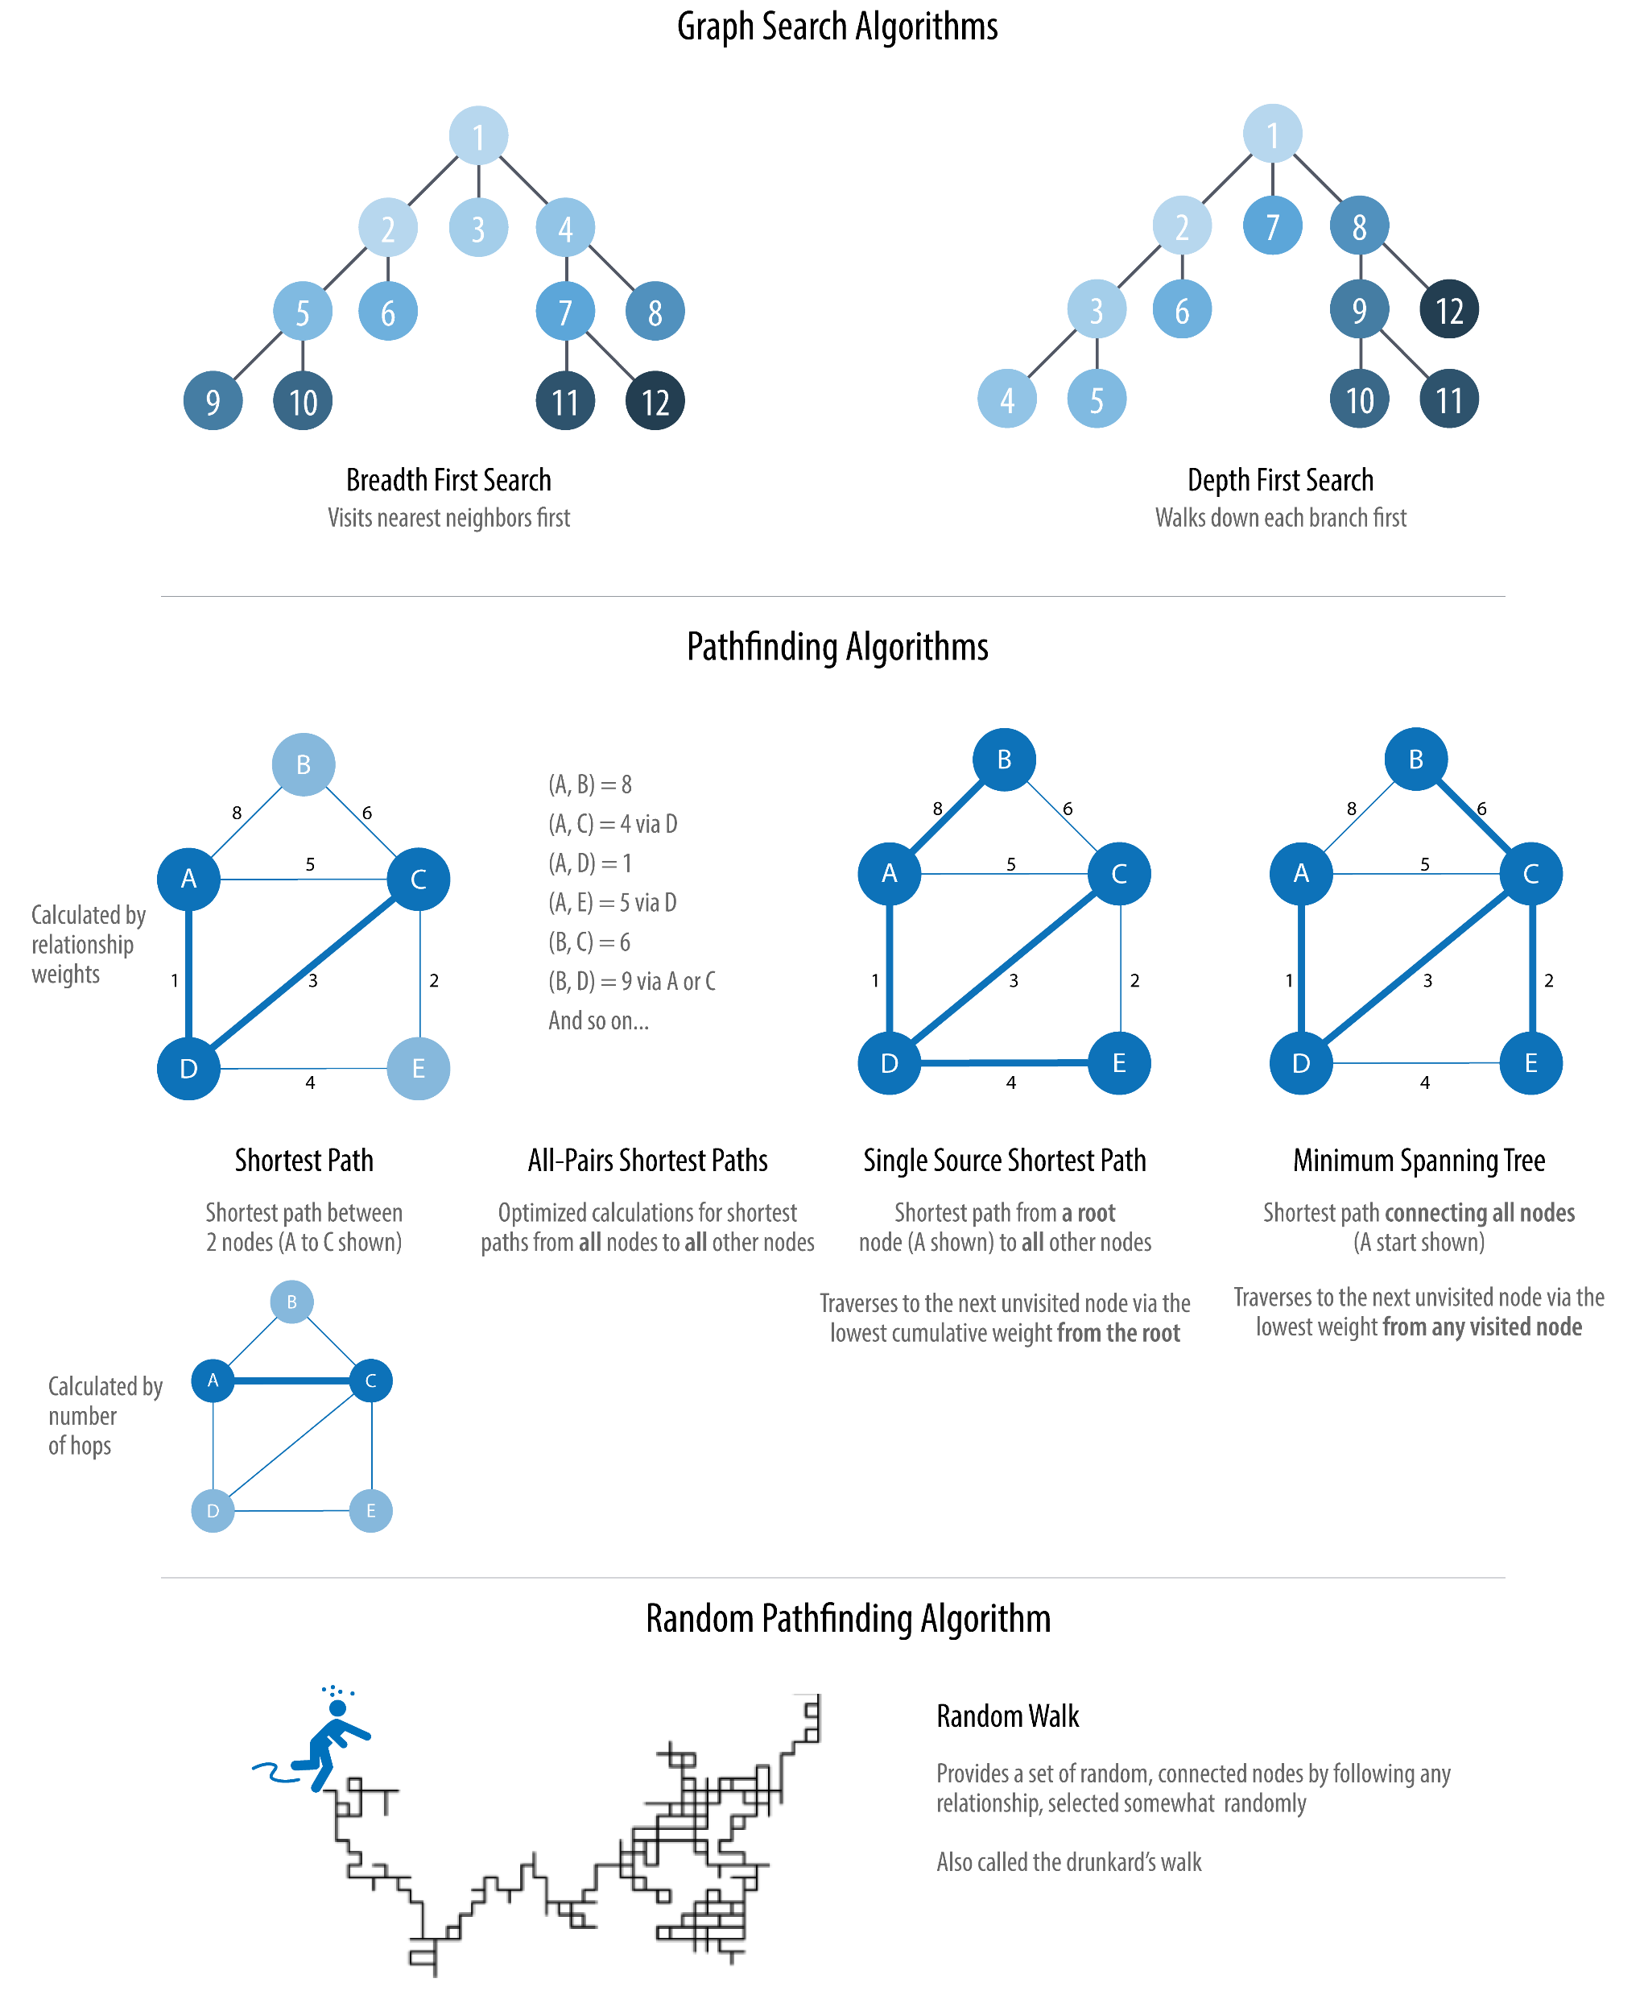
Domain of Artificial Intelligence

Slide 10
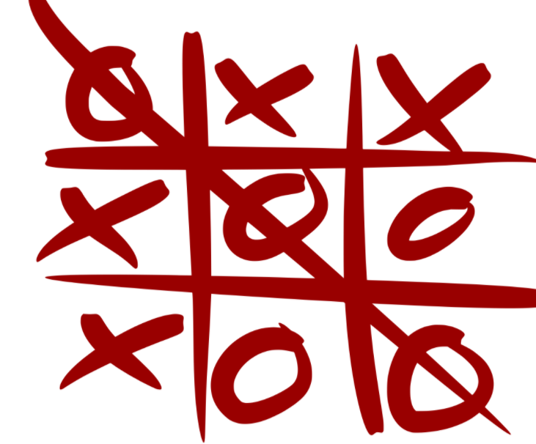
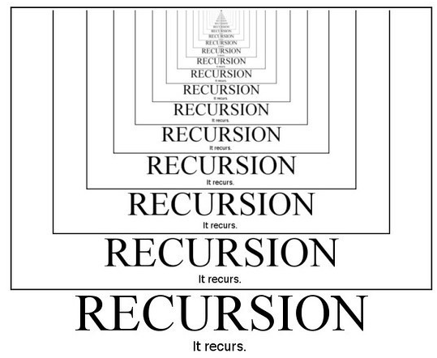
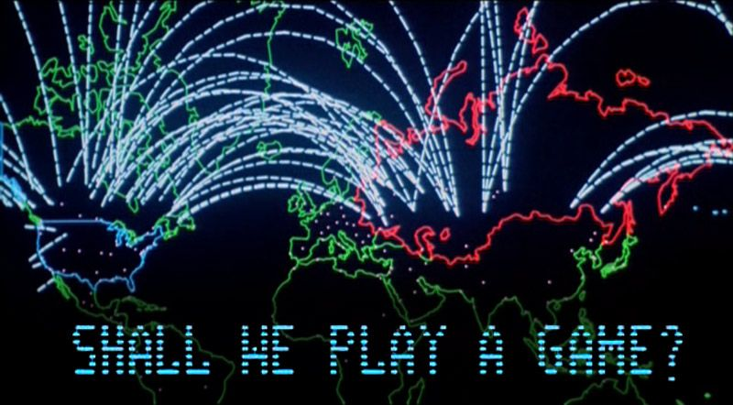
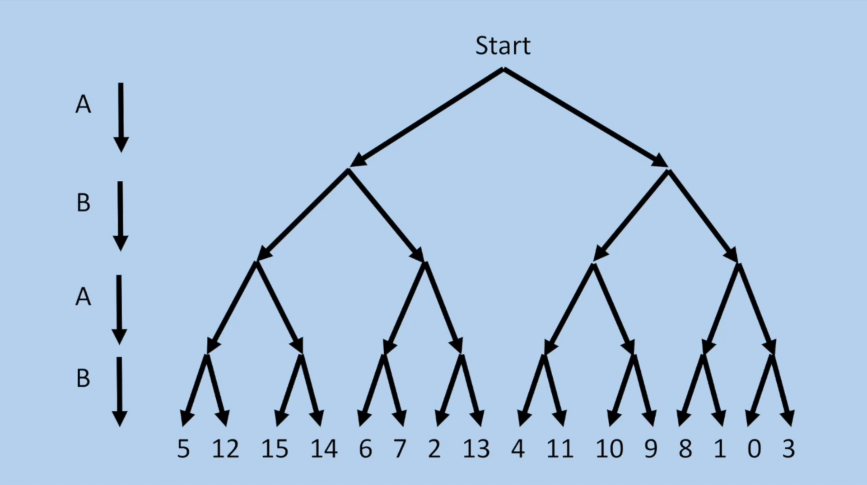
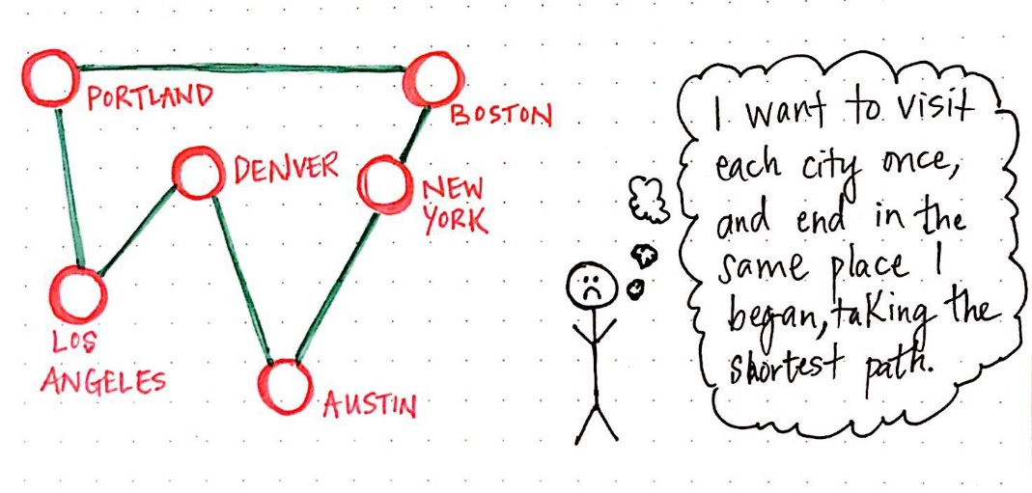
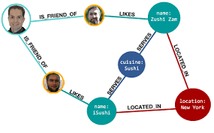
Artificial Intelligence: Games & Graph Search
Discovery
DFS, BFS, Dijkstra, A*; Minimax,…

Slide 11
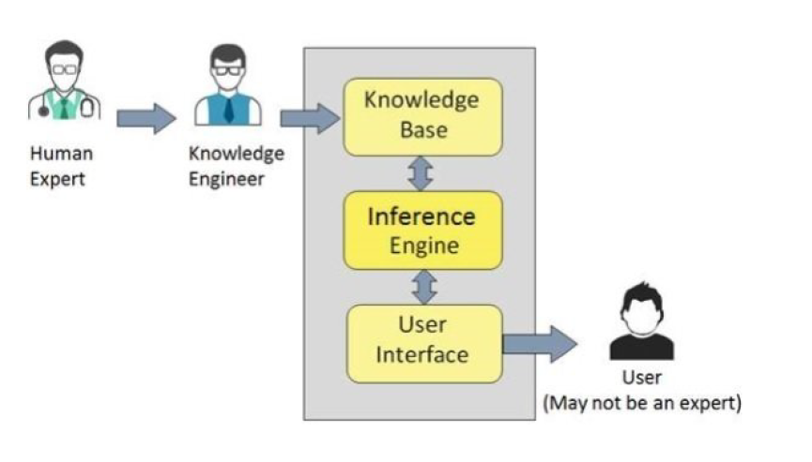
Artificial Intelligence: Expert Systems
Discovery
Facts, Rules
Prolog
‘model’, build by facts & rules

Slide 12
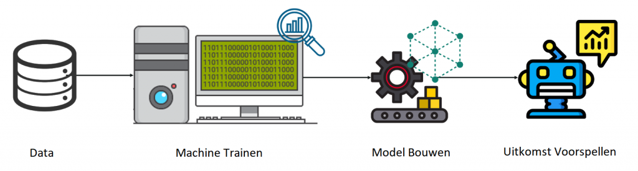
Domain of Machine Learning

Slide 13
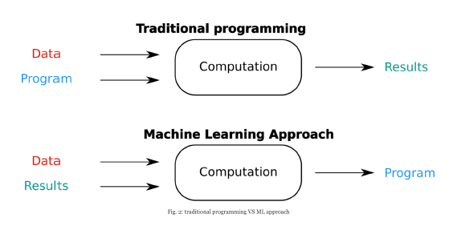

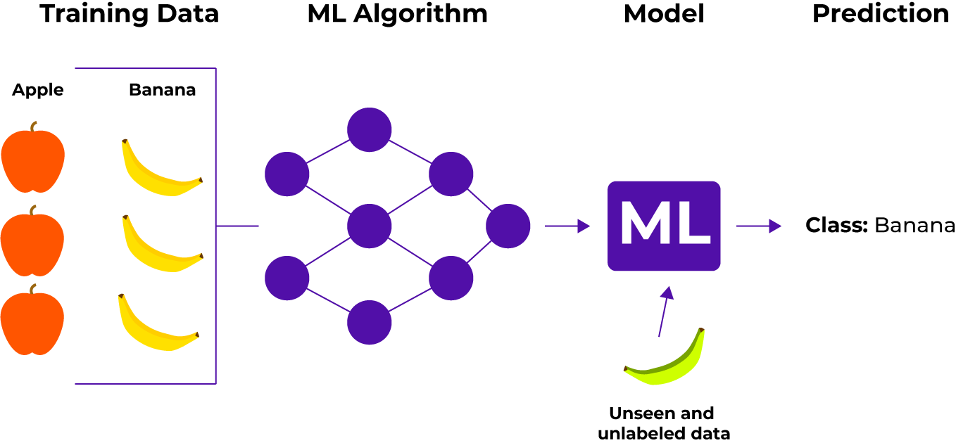
Machine Learning = Data Driven, Learning
Discovery

Slide 14

Machine Learning runs on DATA…
Discovery

Slide 15
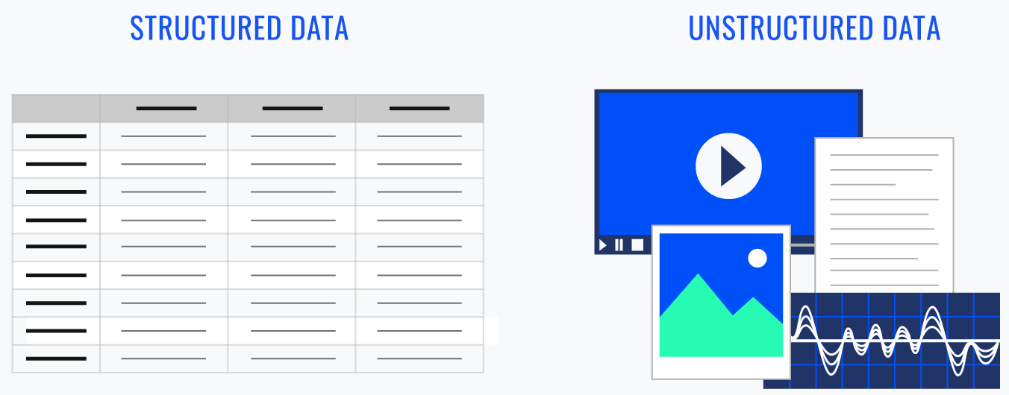
Data, It’s all about the data…
Discovery

Slide 16
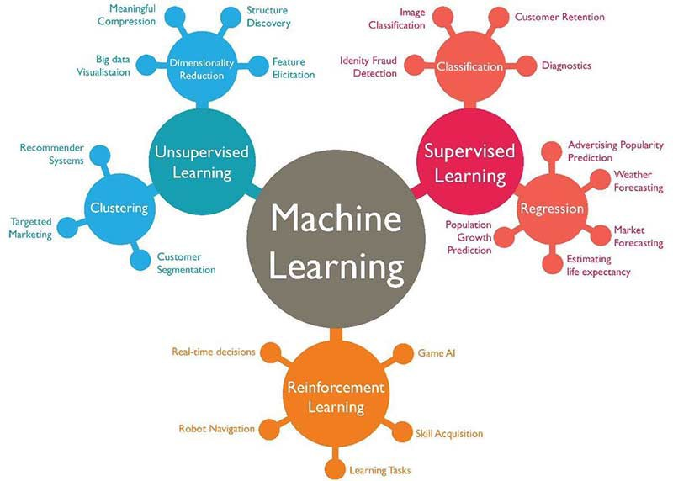
ML: Supervised – Unsupervised – Reinforcement Learning
Discovery

Slide 17
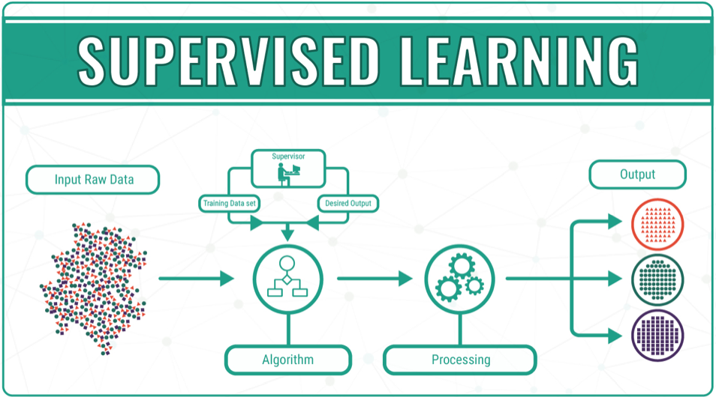
ML Learning: 1. Supervised
Discovery

Slide 18


Classification versus Regression
Discovery

Slide 19
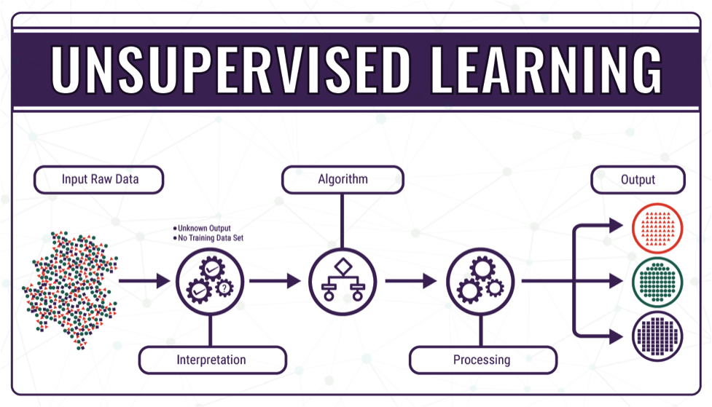
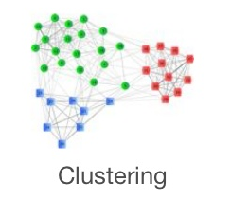
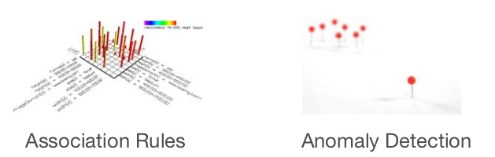
ML Learning: 2. Unsupervised
Discovery

Slide 20
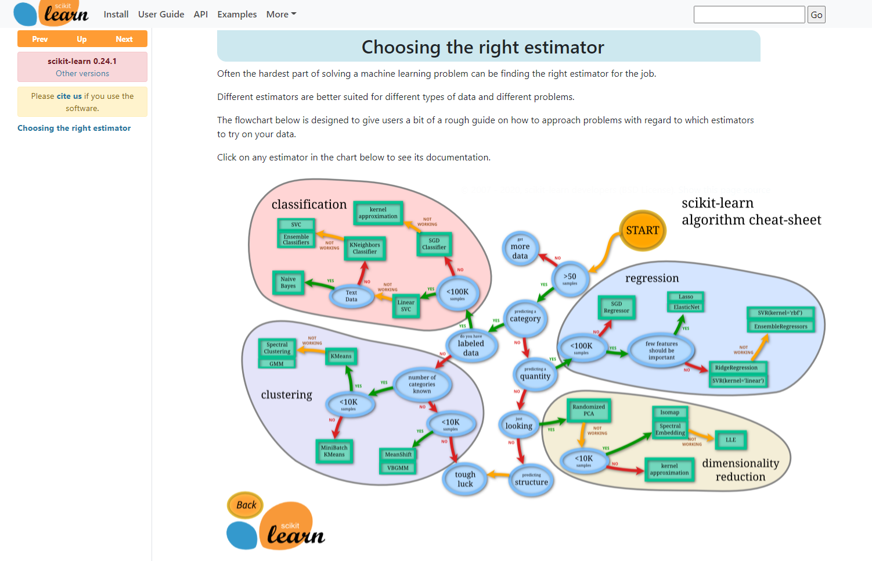
Scikit-Learn: Cheat Sheet
Discovery
Notes:
https://scikit-learn.org/stable/tutorial/machine_learning_map/index.html

Slide 21
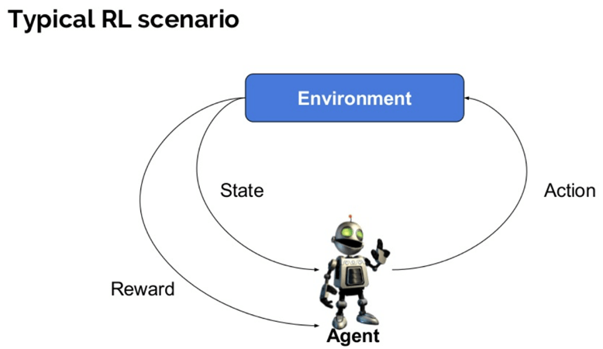
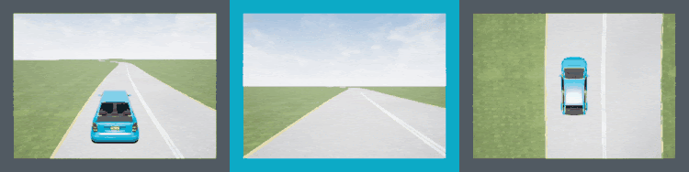
ML Learning: 3. Reinforcement
Discovery

Slide 22
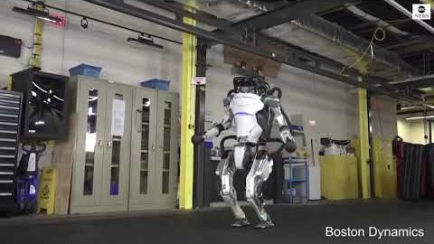
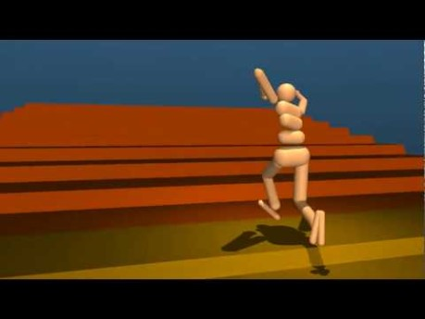
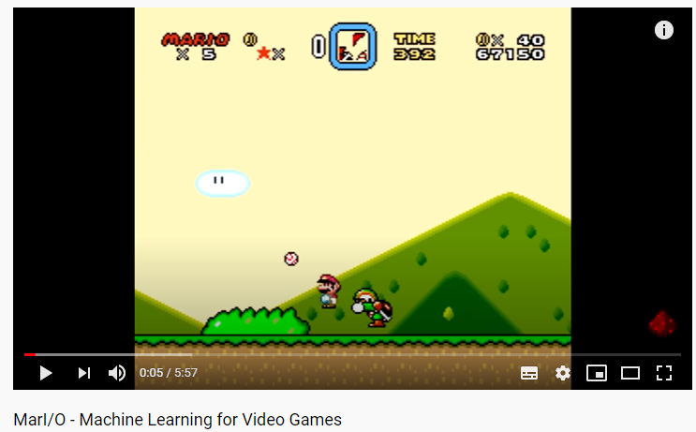
Reinforcement Learning: next big thing?
Discovery
Notes:
Boston Dynamics: https://www.youtube.com/watch?v=_il7PrOUmrA&ab_channel=ABCNews
DeepMind Locomotion: https://www.youtube.com/watch?v=hx_bgoTF7bs&ab_channel=DeepMind
Mari/o: https://www.youtube.com/watch?v=qv6UVOQ0F44&ab_channel=SethBling

Slide 23
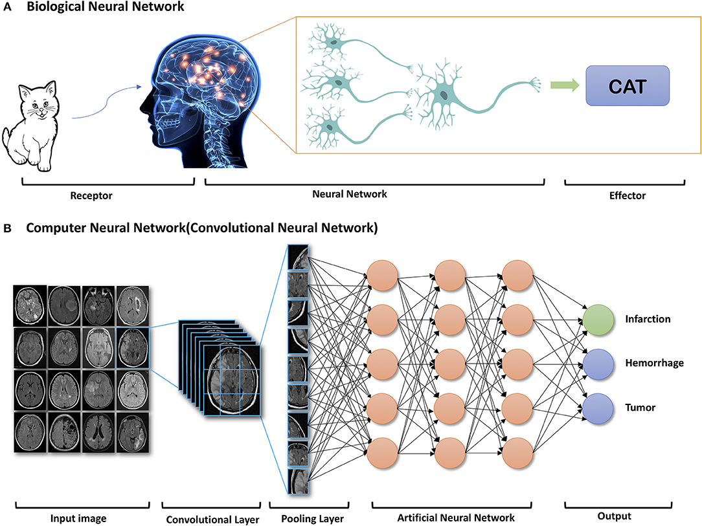
Domain of Deep Learning

Slide 24
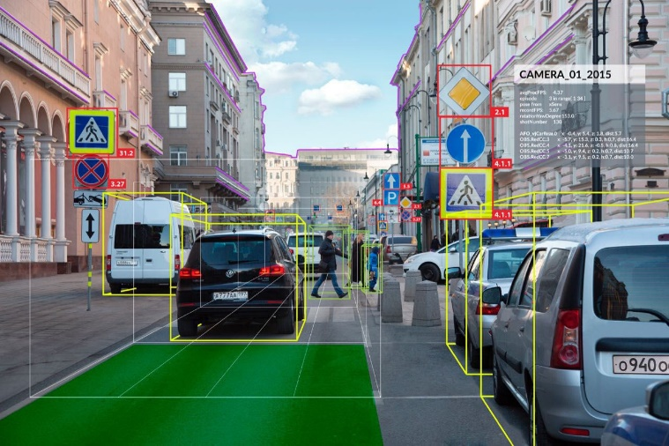
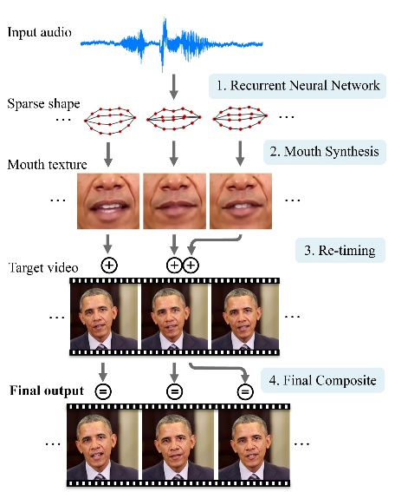

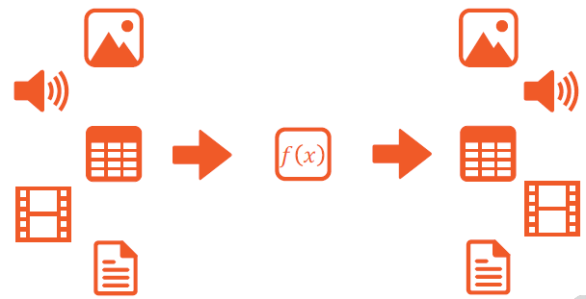
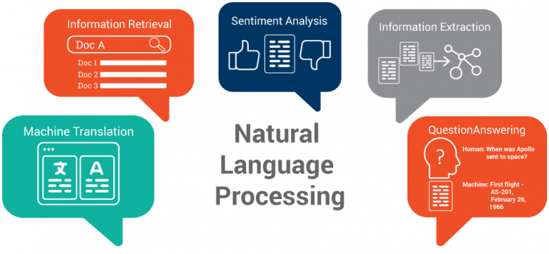
Deep Learning
Discovery
Notes:
YOLO, GAN, NLP

Slide 25
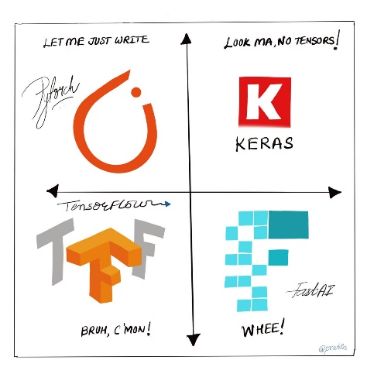
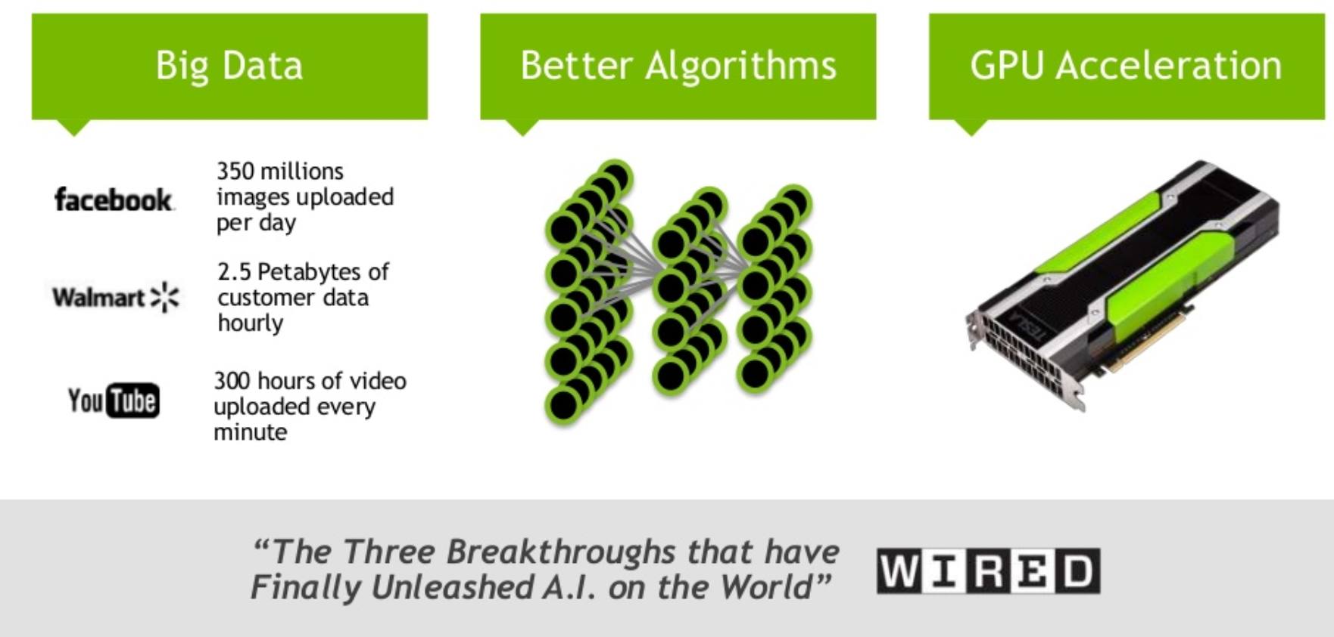
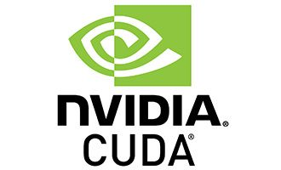
What made Deep Learning feasible?
Discovery
Notes:
Big Data: obvious in this course, but also Transfer learning plays a big part in this (see later in this course). Deep networks are extreme data hungry, but using pretrained networks, and only tweaking them to your needs, requires only ‘little’ amount of data.
Better algorithms: algorithmic breakthroughs solve certain problems (like vanishing gradients), and better optimizers and regularizers are constantly being discovered, tested, and finally deployed in easy to use abstraction frameworks (Keras, Fastai).
GPU acceleration: massive parallelization for the win! Easy to use, abstraction layer in the frameworks (like PyTorch and Tensorflow) makes it extremely easy to use the power of parallelization (for Nvidea GPU’s, because they use CUDA)
TensorFlow (Google) and PyTorch (Facebook) are the 2 most popular deep learning frameworks out there at the moment. Both deal with massive tensor computations and make it easy to perform those on the nvidia GPU, by taking care of the CUDA calls for you. The main difference between the 2 platforms: TensorFlow is like Java: you need to build and compile your entire network before you can feed data into it. PyTorch is like Python: it acts more like an interpreter, instead of a compiler. You can change certain things on the fly, if you want to.
Keras and Fastai are abstraction frameworks on top of those deep learning platforms. They make it easier for you to use deep learning, without coding every nasty detail. They take care of most of the dirty inner stuff and let you focus on your design and training decisions. They use best practices, best default settings under the hood, but you can change those, if you want to. Keras is (mostly) used on top of TensorFlow, and Fastai on top of PyTorch.

Slide 26
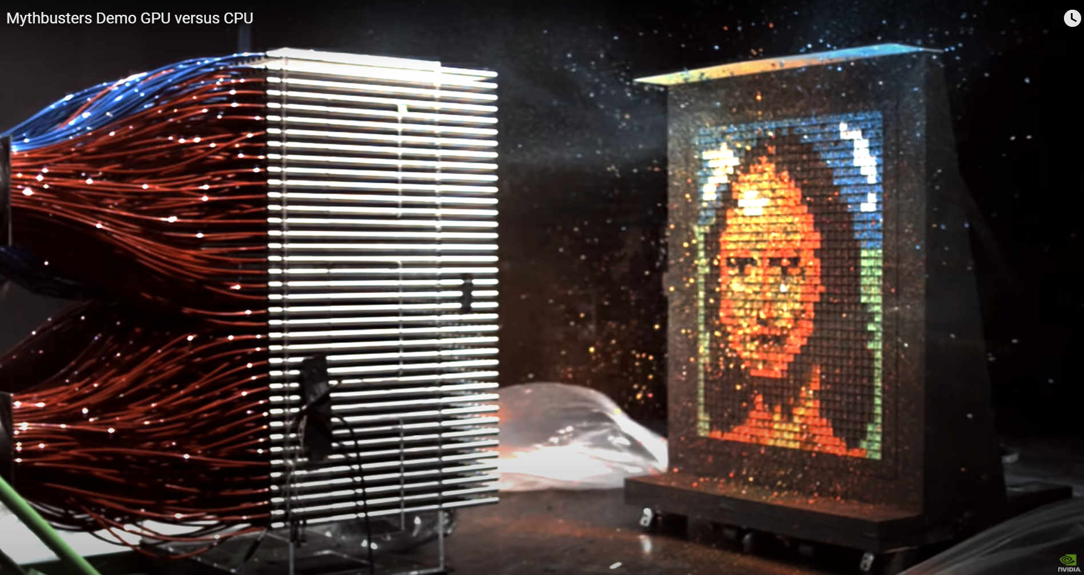
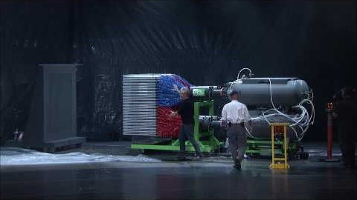
CPU versus GPU Power
Discovery
Notes:
https://www.youtube.com/watch?v=-P28LKWTzrI&ab_channel=NVIDIA
GPU gives you the ability to do massive parallel computations, due to the massive amount op cores it has. Granted, a CPU can have multiple cores as well, and a CPU core is a lot more flexible in the types of workload you could give it. But a GPU has order of magnitude more ‘simple’ cores.
A CPU core can handle lots of different tasks. Think of it like a Navy Seal. And you have a squad of them. You can complete almost any mission with this squad. But sometimes, you don’t need the flexibility of handling any kind of mission, but you need the power of numbers, lots of lots of marines. Think of the GPU as an entire army of marines. You can’t complete any mission with marines (not as flexible), but what would you rather have for storming the beaches of Normandy during D-day: a couple of Navy Seals, or thousands of marines? Which one will get the job done quicker (Navy Seals might eventually conquer the beach as well)?

Slide 27
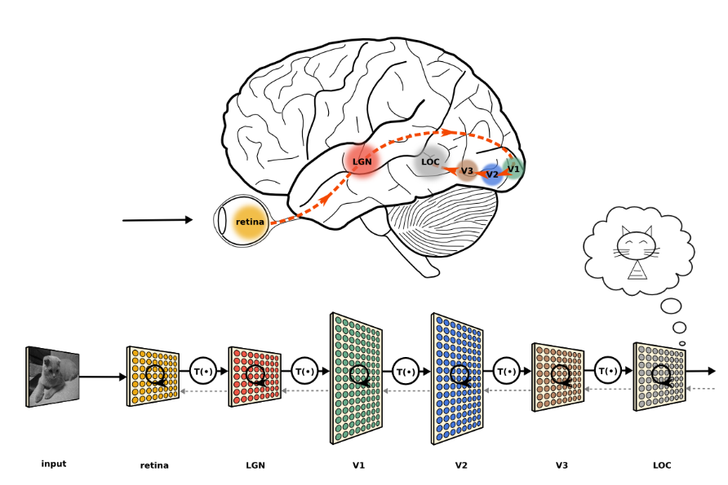
Deep Learning: Neural Network
Discovery

Slide 28
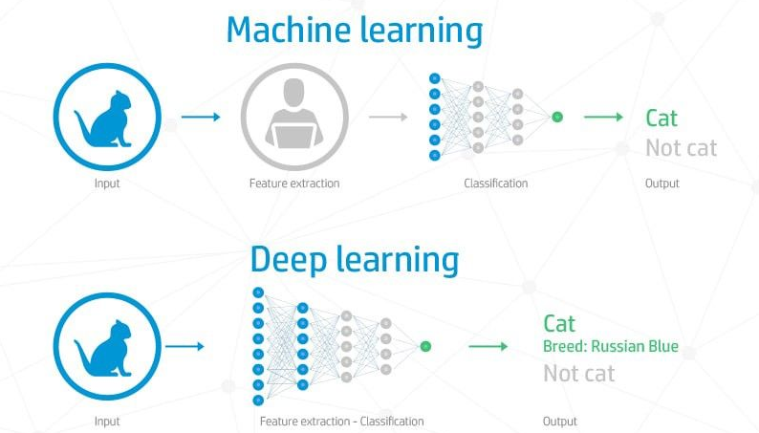
Features: ML versus DL
Discovery

Slide 29
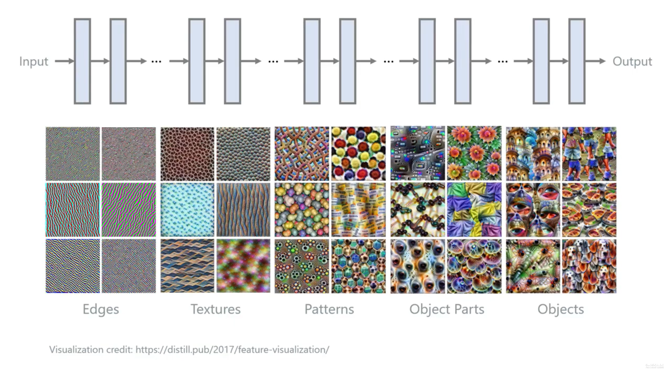
Deep Learning Network
Discovery
Notes:
Let the different layers learn by themselves how to best extract features, so as to map input data to output data. No human feature engineering necessary. That’s why we call this process ‘data driven’. Idea is that early layers extract general, basic features, and subsequent layers combine those basic features in more and more complex ones. Each layer adds a new layer of abstraction, of more complex features = hierarchical model.
But, keep in mind: if each layer is fully connected to the previous layer: the more layers you have, the more weights you have to keep track of (keep in RAM memory), and the more calculations you need to do to update those weights to better fit the problem (= learning)

Slide 30
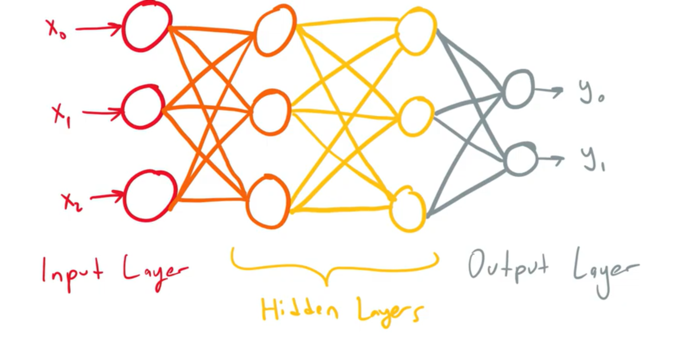
Learning = Tweaking the Weights
Discovery
Notes:
Supervised Learning = data driven, run the data through the network, and see how good/bad your result is. This is the forward pass.
Now use your error to update/tweak the learnable settings of your network, i.e. the weights. Supervised learning means you know the output, so you can check how large your error is. Using this information to tweak the weights of your network, so if you give the same input to the network again, your result will be a little bit better.
This is done with the backwards pass, via backpropagation.
You give the data to the network (in numbers, because we have to do calculations), and each neuron does its calculations (multiplying the inputs by their weights, sum it up, project it unto the activation function which generates the output, and give this output to the next layer). If you do this for all neurons in a layer, and for all layers, you will eventually reach the output layer. This neuron might be a classifier neuron for detecting a rabbit versus a fish. If it fires (after calculating the weighted sum and projecting it to its activation function), it’s a rabbit. If not, it’s a fish. Firing means that the result is close to one. Not firing is close to zero. So if your result is 0,6, you fire, and it’s a rabbit according to your current settings of the network. If this is true (you know your output in the training phase = supervised learning), you can now calculate your error = 0,4. So if we can now tweak all the weights in our network just a little, so next time we give it the same input, the output will be 0,65 for instance (an error of 0,35) we would have learned to better classify the input.
Knowing how to adjust the weights for this to happen, is done in the backwards pass, through ‘backpropagating the error’. This backpropagation uses the principle of gradient descent.

Slide 31
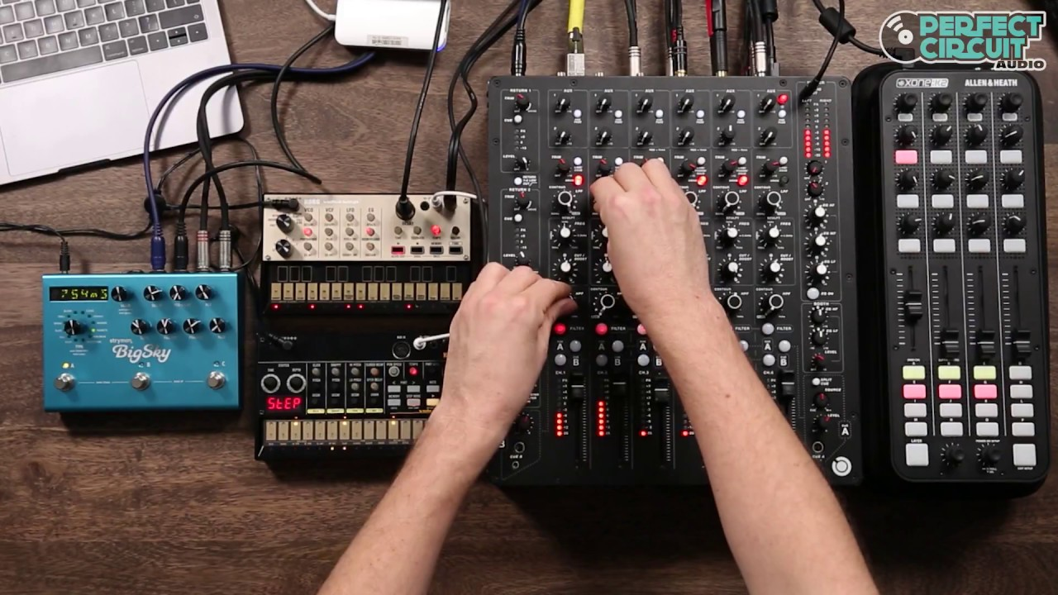
Tweaking the Weights
Discovery
Notes:
The weights of the network = knowledge learned = ‘intelligence’ of the network, the most important piece of the model

